Slide 1
7.4 Notes
The Indefinite Integral

Slide 2

A function F is the antiderivative of f if on an interval I if F’(x)=f(x) for all x in the interval
i.e. $\frac{d}{dx} F(x) = f(x)$

Slide 3
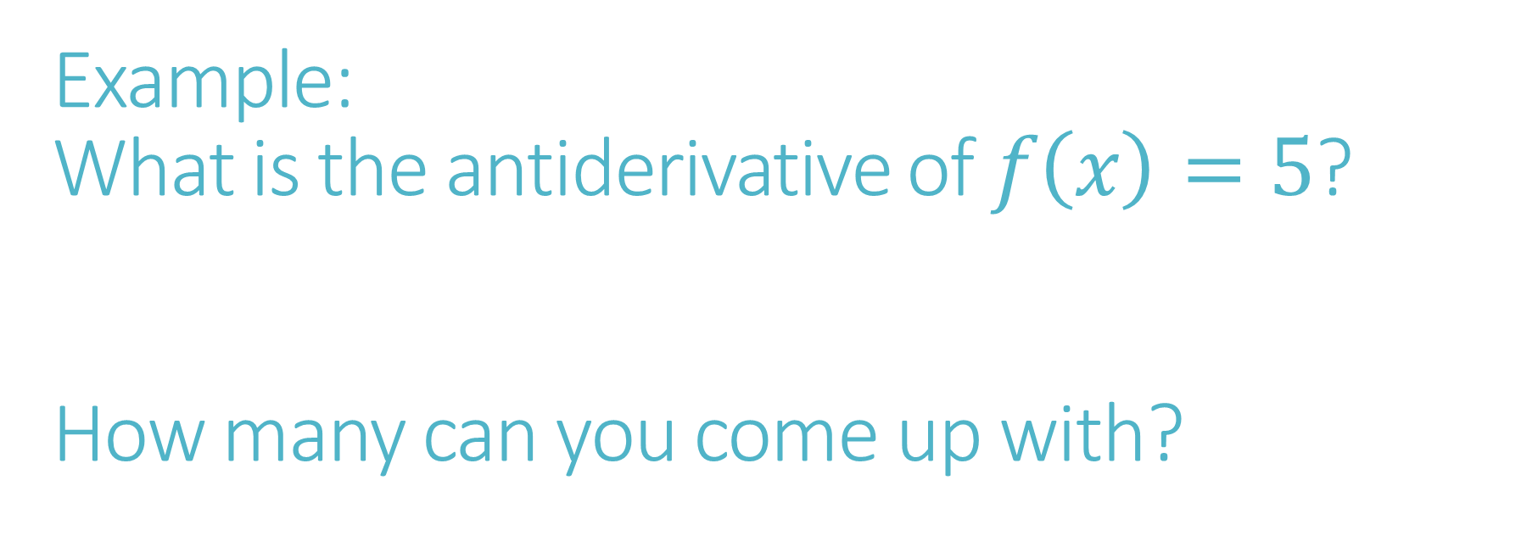
Example: What is the antiderivative of $f\left(x\right)=5$? How many can you come up with?
Theorem:
If F(x) is an antiderivative of f(x) on I, then F(x) + C (where C is a constant) is also an antiderivative

Slide 4
Finding antiderivatives is called Integration
Integral Notation
$$\int{f\left(x\right)dx}=F\left(x\right)+C$$
Example: $\int{x^{2}dx}=\frac{1}{3}x^{3}+C$ means the same thing as $\frac{d}{dx}\left(\frac{1}{3}x^{3}+c\right)=x^{2}$
dx denotes the independent variable in both.
Sometimes it’s written like this: $\int{1dx}=\int{dx}$
or like this: $\int{\frac{1}{x^{3}}dx}=\int{\frac{dx}{x^{3}}}$

Slide 5
Power Rule for Integration
Handout: Other Integration Rules

Slide 6
Properties of Integration
Constant Factor
Sum/Difference

Slide 7
Example 1: $\int{4 cosx dx}$

Slide 8
Example 2: $\int{(12x^{5}+3x^{3}−x^{2}+2)}dx$

Slide 9
Example 3: $$\int{\frac{cosx}{sin^{2}x}}dx$$

Slide 10
Example 4: $$\int{\frac{t^{2}−2t^{4}}{t^{4}}dt}$$

Slide 11
Example 5
Find an equation for a curve that passes through the point (2,1) and whose tangent line at any point $\left(x, f\left(x\right)\right)$ has slope $x^{2}.$

Slide 12
Practice: Textbook Section 6.2 #1, 3, 11, 13-29 every other odd, 39 – 47 every other odd

Slide 13

“Differential Equations” and “Initial-value problems”
Solve the initial-value problem $\frac{dy}{dx}=\cos{x}, y\left(0\right)=1$
Same as $\frac{d}{dx}f\left(x\right), f\left(0\right)=1$

